Slide 1
Pipes and Filters
Architecture Patterns:

Slide 2
Definition
"The Pipes and Filters architectural pattern provides a structure for systems that process a stream of data. Each processing step is encapsulated in a filter component. Data [are] passed through pipes between adjacent filters. Recombining filters allows you to build families of related filters." [Buschmann]⁽²⁾
Notes:
Important quote by Buschmann that summarizes the utility and format of Pipes and Filters.

Slide 3
Problem⁽²⁾
Several developers build
Can be divided into several processes
Separate processes
Work independently
Form a cohesive whole
Is flexible with change
Notes:
What kind of things does this Architectural Pattern need to accomplish?
What is it going to be utilized for?

Slide 4
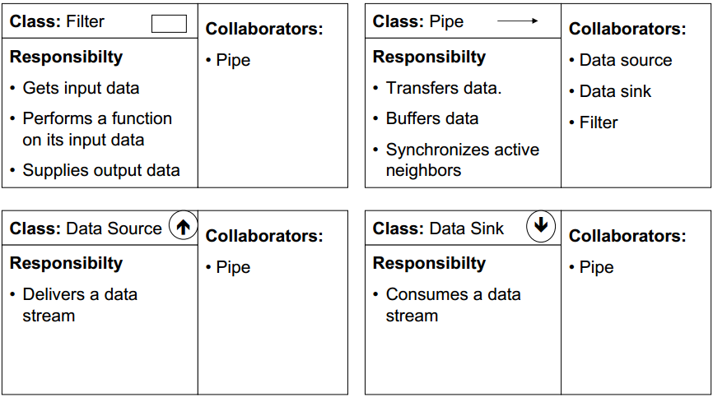
Class Responsibility Cards⁽¹⁾
Notes:
“Data source” AKA“Data Pump”
Two types of filters:
Active – Separate process; pulls data from pump and pushes transformed data to output
Passive – actively either called as a:
Function – pull output from filter
Procedure – push data into filter

Slide 5
Forces⁽²⁾
Separate filters should be interchangeable, replaceable and moveable
Non-adjacent steps share no info
Can execute parallel steps
Can display/store final results many ways
Various sources of data input
Small and many rather than big and few
No more than one action per step
Notes:
Deeper description of the previous slides’ Class Responsibility collaboration cards.

Slide 6
Implementation⁽²⁾
Divide the problem
Define data type and format
Decide how to make pipe connections
Design and implement the filters
Decide how to handle errors
Configure the system and run it
Notes:
Steps depend on each other for information
Sometimes one of those elements needs to be a converter/translator/decoder to make data readable
Active vs passive filters
Each filter needs different implementation
Active filter: needs its own “thread of control” (address)
Passive filter: does not need it
There needs to be a system for letting the user know of errors and how to handle them without backing up the system.
Using a standard program to create the pipeline.

Slide 7
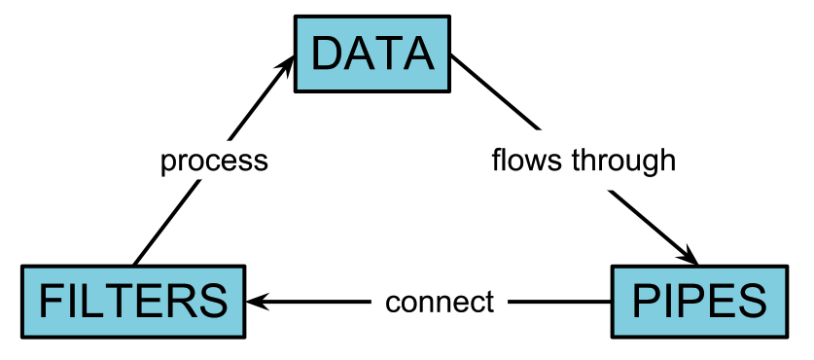
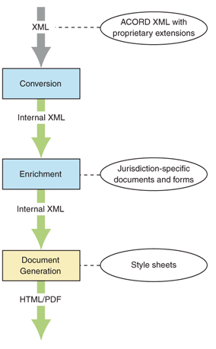
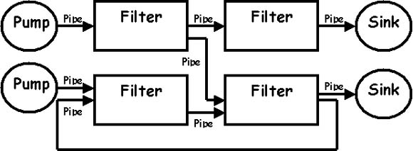

Example Pipes
Notes:
Generalized and specific examples of pipes and filters, as well as a circular logic diagram giving a simple description.

Slide 8
References
(1): http://www.csee.wvu.edu/~ammar/CU/swarch/lecture%20slides/slides%204%20sw%20arch%20styles/supporting%20slides/SWArch-4-PipesandFilter.pdf
(2): http://www.cs.olemiss.edu/~hcc/csci581oo/notes/pipes.html
(3): http://msdn.microsoft.com/en-us/library/ee658117.aspx
(4): http://pubs.opengroup.org/architecture/togaf9-doc/m/chap25.html
(5): http://enterpriseintegrationpatterns.com/PipesAndFilters.html
(6): http://www.dossier-andreas.net/software_architecture/pipe_and_filter.html
(7): http://teaching.software-carpentry.org/2012/09/06/week-1-shell-pipes-and-filters/
(8): http://i.msdn.microsoft.com/dynimg/IC22368.gif

